Slide 1
Introduction to Parsing
Instructor
Dr. Shamim H Ripon
dshr@ewubd.edu
http://sites.google.com/site/shripon

Slide 2
Outline
Parser overview
Context-free grammars (CFG)
Derivations
Ambiguity

Slide 3
Parser position
Lexical
analyzer
token
parser
Rest of
front end
Source
program
parse
tree
intermediate
representation
get next
token
symbol
table

Slide 4
Functionality of Parser
Input
Sequence of tokens from lexer
Output
Parse tree of the program
(some parsers never produce a parse tree)

Slide 5
Example
if x = y then 1 else 2
Parser input
IF ID = ID THEN INT ELSE INT
Parser output
IF-THEN-ELSE
=
INT
INT
ID
ID

Slide 6
Lexer vs Parser
Phase | Input | Output
Lexer | String of characters | String of Tokens
Parser | String of token | Parse tree

Slide 7
Role of Parser
Not all strings of tokens are programs..
….Parser must distinguish between valid and invalid strings of tokens
We need
A language for describing valid strings of tokens
A method for distinguishing valid from invalid strings of tokens

Slide 8
Context-free Grammar
Programming language constructs have recursive structure
An EXPR is
if EXPR then EXPR else EXPR fi
while EXPR loop EXPR pool
Context-free grammars are a natural notation for this recursive structure

Slide 9
Context-free grammar(CFG)
A CFG consists of
A set of terminals
A set of non-terminals
A start symbol S (nonterminal)
A set of production
How terminals and non-terminals form strings
head or left side
or ::=
right side

Slide 10
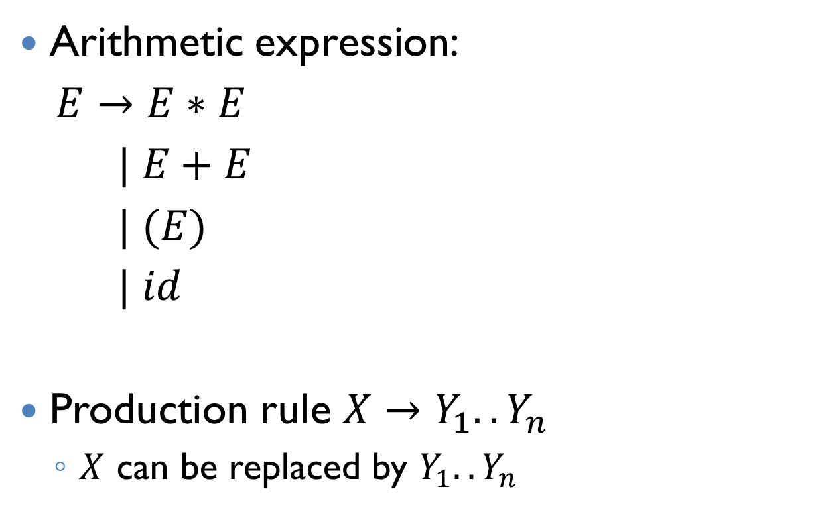
Example
Arithmetic expression:
$E→E∗E$
$| E+E$
$| (E)$
$| id$
Production rule $X→Y_{1}{..Y}_{n}$
$X$ can be replaced by $Y_{1}{..Y}_{n}$

Slide 11
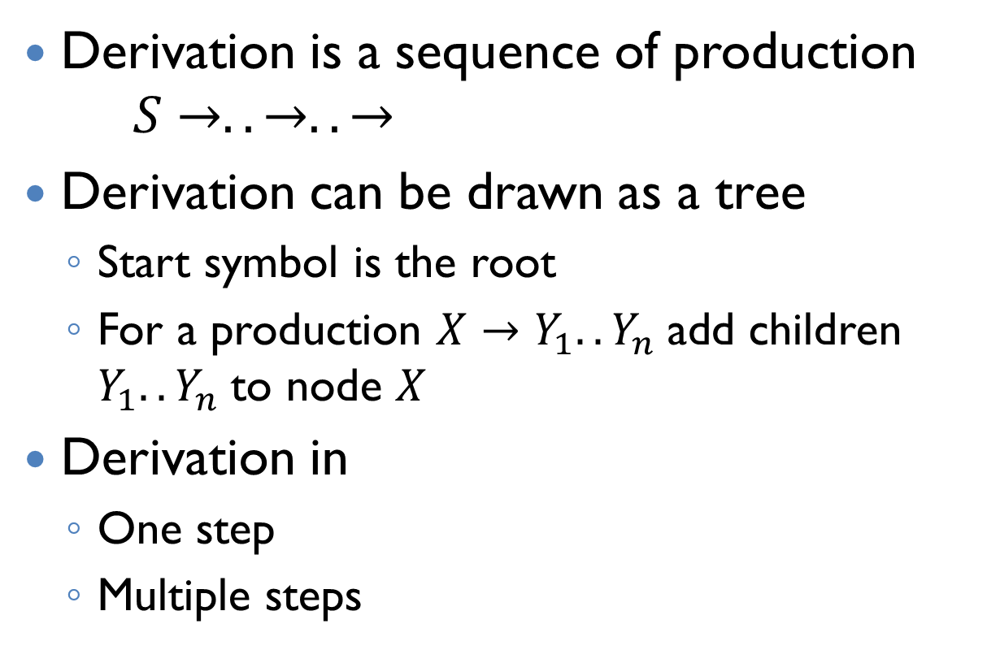
Derivation
Derivation is a sequence of production
$$S→..→..→$$
Derivation can be drawn as a tree
Start symbol is the root
For a production $X→Y_{1}{..Y}_{n}$add children $Y_{1}{..Y}_{n}$to node $X$
Derivation in
One step
Multiple steps

Slide 12
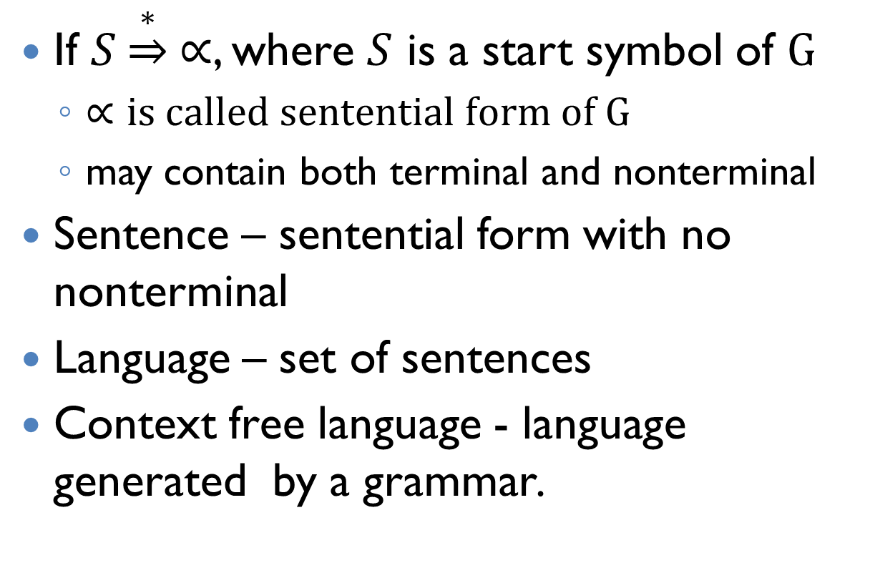
Derivation (cont.)
If $S\underset{⇒}{∗} ∝$, where $S$ is a start symbol of $G$
$∝is called sentential form of G$
may contain both terminal and nonterminal
Sentence – sentential form with no nonterminal
Language – set of sentences
Context free language - language generated by a grammar.

Slide 13

Derivation example
Grammer:
$$E→E+E \left| E∗E \right| \left(E\right)| id$$
String:
$$id∗id+id$$

Slide 14
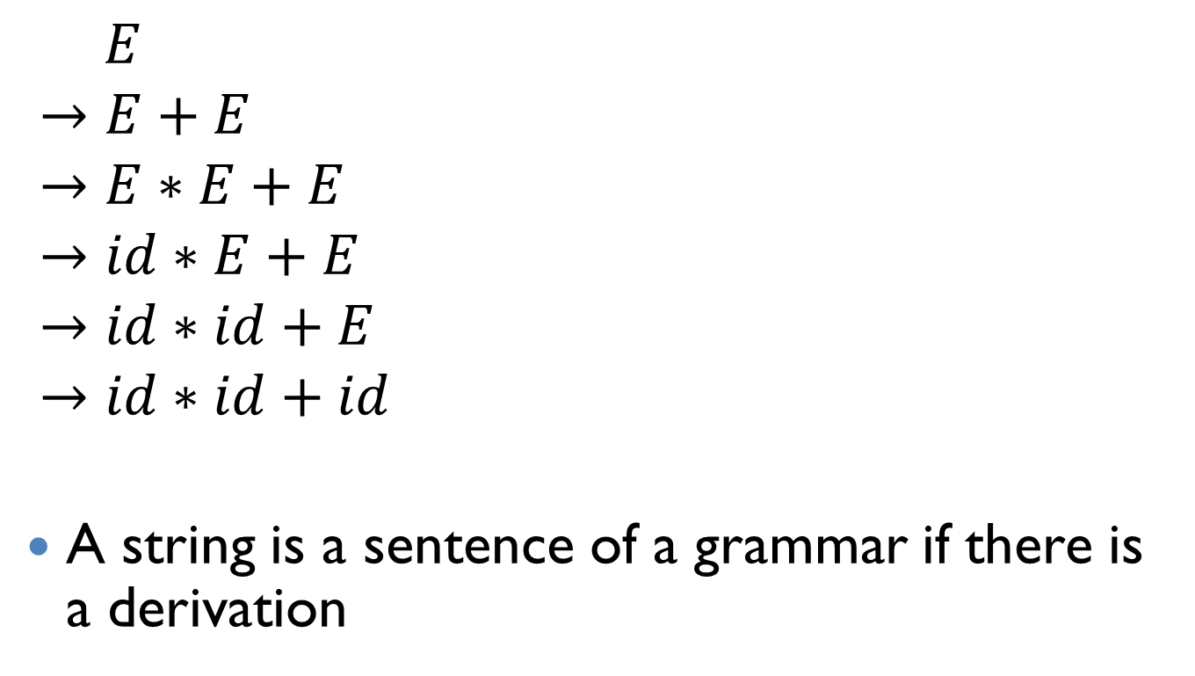
Example (Cont.)
E
$$E$$
$$→E+E$$
$$→E∗E+E$$
$$→id∗E+E$$
$$→id∗id+E$$
$$→id∗id+id$$
A string is a sentence of a grammar if there is a derivation
E
+
E
E
*
E
id
id
id

Slide 15
Derivation notes
A parse tree has
Terminal as leaves
Nonterminal as interior nodes
In-order traversal of the leaves gives original input
Parse tress shows the association of operations, the input string does not.

Slide 16

Left-most and Right-most derivation
Left-most – at each step replace the left most nonterminal
Right-most
$$E$$
$$→E+E$$
$$→E+id$$
$$→E∗E+id$$
$$→E∗id+id$$
$$→id∗id+id$$

Slide 17
Left-most and Right-most derivations have the same parse tree.
The difference is the order in which branches are added

Slide 18
So far
We need a parse tree for a string of a language.
A derivation defines a parse tree
But one parse tree may have many derivations
Left-most and right-most derivations are important in parser implementation

Slide 19
Ambiguity
Grammer:
$$E→E+E \left| E∗E \right| \left(E\right)| id$$
String:
$$id∗id+id$$

Slide 20
Ambiguity (cont.)
The string has two parse trees
E
E
E
+
E
E
+
E
E
*
E
id
E
*
E
id
id
id
id
id

Slide 21
Ambiguity (cont.)
A grammar is ambiguous if it has more than one parse tree for some string
Equivalently, there is more than one right-most or left-most derivation for some string
Ambiguity is BAD
Leaves meaning of some programs ill-defined

Slide 22
Dealing with Ambiguity
Several ways to handle ambiguity
Most direct way
Rewrite grammar unambiguously
Enforce operator precedence
More on next lecture

